Slide 1
PBCST304 Object Oriented Programming in Java
Module 4
(Part 3)
Prepared by
Renetha J.B.

Slide 2
Topics
Swings
  Swing packages
  Exploring Swings
    JFrame
    Jlabel
    The Swing Buttons
    JTextField

Slide 3
Swing Packages
Swing is a very large subsystem and makes use of many packages.
  These are the packages used by Swing that are defined by Java SE 6.
The main package is javax.swing.
  This package must be imported into any program that uses Swing.
  It contains the classes that implement the basic Swing components, such as push buttons, labels, and check boxes.

Slide 4
Swing packages(contd.)
javax.swing | javax.swing.border | javax.swing.colorchooser
javax.swing.event | javax.swing.filechooser | javax.swing.plaf
javax.swing.plaf.basic | javax.swing.plaf.metal | javax.swing.plaf.multi
javax.swing.plaf.synth | javax.swing.table | javax.swing.text
javax.swing.text.html | javax.swing.text.html.parser | javax.swing.text.rtf
javax.swing.tree | javax.swing.undo

Slide 5
Some of the swing components are:
  JButton
  JCheckBox
  JComboBox
  JLabel
  JList
  JRadioButton
  JScrollPane
  JTabbedPane
  JTable
  JTextField
  JToggleButton
  JTree
These components are all lightweight. They are all derived from JComponent.

Slide 6
  Exploring Swings
    JFrame
    Jlabel
    The Swing Buttons
    JTextField

Slide 7
JFrame
Every containment hierarchy must begin with a top-level container.
JFrame is a top level container that is commonly used for Swing applications.
JFrame do not inherit JComponent.
JFrame inherit the AWT classes Component and Container.
The top-level containers are heavyweight.

Slide 8
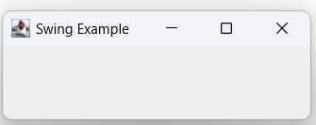
JFrame(contd.)
JFrame frame = new JFrame(“Swing Example);
This creates a container called frame that
  defines a rectangular window complete with a title bar; close, minimize, maximize, and restore buttons; and a system menu.
  Thus, it creates a standard, top-level window.
  The title of the window(“Swing Example”) is passed to the constructor.

Slide 9
JFrame(contd.)
The setSize( ) method (which is inherited by JFrame from the AWT class Component) sets the dimensions of the window, which are specified in pixels.
Its general form is :
void setSize(int width, int height)
E.g.
JFrame frame = new JFrame(“Swing Example);
frame.setSize(275, 100);

Slide 10
JFrame(contd.)
If we want the entire application to terminate when its top-level window is closed, the easiest way is to call setDefaultCloseOperation( )
E.g.
frame.setDefaultCloseOperation(JFrame.EXIT_ON_CLOSE);
After this call, closing the window causes the entire application to terminate.
The general form of setDefaultCloseOperation( ) is :
void setDefaultCloseOperation(int what)
  what can be
    JFrame.EXIT_ON_CLOSE
    JFrame.DISPOSE_ON_CLOSE
    JFrame.HIDE_ON_CLOSE
    JFrame.DO_NOTHING_ON_CLOSE

Slide 11
JFrame(contd.)
The content pane can be obtained by calling getContentPane( ) on a JFrame instance.
The getContentPane( ) method is :
Container getContentPane( )
The setVisible( ) method is inherited from the AWT Component class.
  Argument can be true or false
  If its argument is true, the window will be displayed. Otherwise, it will be hidden.
    By default, a JFrame is invisible, so setVisible(true) must be called to make it visible.
  E.g.
    frame.setVisible(true);

Slide 12
A Simple Swing Application
There are two types of Java programs in which Swing is typically used.
  desktop application.
  applet

Slide 13
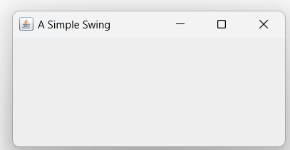
Create a Swing with a frame titled “A Simple Swing”
import javax.swing.*;
class SimpleSwing
{
SimpleSwing()
{
JFrame f = new JFrame("A Simple Swing ");
f.setSize(400, 200);
f.setDefaultCloseOperation(JFrame.EXIT_ON_CLOSE);
f.setVisible(true);
}
public static void main(String args[])
{
new SimpleSwing();
}
}

Slide 14
Create a Swing with a frame titled “A Simple Swing”
import javax.swing.*;
class SimpleSwing
{ JFrame f ;
SimpleSwing()
{
    // Create a new JFrame container. With title- A Simple Swing
    f= new JFrame("A Simple Swing ");
    // Give the frame an initial size. Width=400 height =200
    f.setSize(400, 200);
    // Terminate the program when the user closes the application.
    f.setDefaultCloseOperation(JFrame.EXIT_ON_CLOSE);
  // Display the frame.
  f.setVisible(true);
    }
public static void main(String args[])
{
new SimpleSwing();
}
}

Slide 15
JLabel
JLabel is Swing’s easiest-to-use component.
It creates a label.
JLabel can be used to display text and/or an icon.
It is a passive component because it does not respond to user input.
  We cannot edit or type label content when we execute the application.
JLabel defines several constructors:
  JLabel(Icon icon)
  JLabel(String str)
  JLabel(String str, Icon icon, int align)
  The align argument specifies the horizontal alignment of the text and/or icon within the dimensions of the label.
    It must be one of the following values: LEFT, RIGHT, CENTER, LEADING, or TRAILING

Slide 16
JLabel(contd.)
The easiest way to obtain an icon is to use the ImageIcon class.
ImageIcon implements Icon and encapsulates an image.
The following ImageIcon constructor obtains the image in the file named filename. the Icon parameter of JLabel’s constructor
  ImageIcon(String filename)
The icon and text associated with the label can be obtained by the following methods:
  Icon getIcon( ) helps to retrieve icon in label
  String getText( ) helps to retrieve text written in label
The icon and text associated with a label can be set by these methods:
  void setIcon(Icon icon)
  void setText(String str)

Slide 17
A Simple Swing Application
Q. Write a swing program that uses two Swing components: JFrame and JLabel. The program uses a JFrame container to hold an instance of a JLabel. The label displays a short text message “Swing is powerful GUI”

Slide 18
import javax.swing.*;
class SwingDemo
{
JFrame f;
JLabel lab1;
  SwingDemo()
  {
    // Create a new JFrame container. With title- A Simple Swing
    f= new JFrame("A Simple Swing ");
    // Give the frame an initial size. Width=400 height =300
    f.setSize(400, 300);
    // Terminate the program when the user closes the application.
    f.setDefaultCloseOperation(JFrame.EXIT_ON_CLOSE);

Slide 19
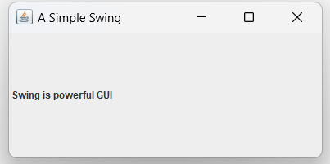
  // Create a text-based label
  lab1 = new JLabel(" Swing is powerful GUI");
  // Add the label to the content pane.
  f.add(lab1);
  // Display the frame.
  f.setVisible(true);
}
public static void main(String args[])
{
  new SwingDemo();
  }
  }
Too compile this program,
javac SwingDemo.java
To run the program,
java SwingDemo

Slide 20
// A simple Swing application.
import javax.swing.*;
class SwingDemo
{
JFrame f ;
JLabel lab1 ;
  SwingDemo()
  {
    f = new JFrame("A Simple Swing ");
    f.setSize(275, 100);
    f.setDefaultCloseOperation(JFrame.EXIT_ON_CLOSE);
    lab1 = new JLabel(" Swing is powerful GUI");
    f.add(lab1);
    f.setVisible(true);
  }
  public static void main(String args[])
  {
  new SwingDemo();
  }
}

Slide 21
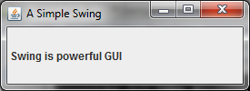
javax.swing defines classes that implement labels, buttons, text controls, and menus.
The constructor is where most of the action of the program occurs. It begins by creating a JFrame, using this line of code:
JFrame f = new JFrame("A Simple Swing ");
This creates a container called f that defines a rectangular window complete with a title bar; close, minimize, maximize, and restore buttons; and a system menu.
Thus, it creates a standard, top-level window.
The title of the window is passed to the constructor of JFrame
  Here title is A Simple Swing

Slide 22
The next line of code creates a Swing JLabel component:
JLabel lab1 = new JLabel(" Swing is powerful GUI");
The next line of code adds the label to the content pane of the frame:
frame.add(jlab);
Thus, to add a component to a frame, we must add it to the frame’s content pane. This is accomplished by calling add( ) on the JFrame reference (jfrm in this case). The general form of add( ) is:
Component add(Component comp)

Slide 23
The content pane can be obtained by calling getContentPane( ) on a JFrame instance
Container getContentPane( )
The last statement in the SwingDemo constructor causes the window to become visible:
f.setVisible(true);

Slide 24
SwingDemo constructor is invoked using the following lines of code:
new SwingDemo();
Swing programs are event-driven.

Slide 25
The Swing Buttons
Swing defines four types of buttons:
  JButton - is the push button
  JToggleButton
  JCheckBox
  JRadioButton
All are subclasses of the AbstractButton class (which extends JComponent)

Slide 26
The Swing Buttons(contd.)
AbstractButton contains many methods that allow to control the behavior of buttons.
E.g. We can define different icons that are displayed when button is disabled, pressed, or selected. Another icon can be used as a rollover icon, which is displayed when the mouse is positioned over a button.
  void setDisabledIcon(Icon di)
  void setPressedIcon(Icon pi)
  void setSelectedIcon(Icon si)
  void setRolloverIcon(Icon ri)
  Here, di, pi, si, and ri are the icons for specific purpose

Slide 27
The Swing Buttons (contd.)
We can get the text associated with a button using:
  String getText( )
We can modify the text associated with a button using:
  void setText(String str)
The model used by all buttons is defined by the ButtonModel interface.

Slide 28
JButton
The JButton class provides the functionality of a push button.
JButton allows an icon, a string, or both to be associated with the push button.
Three of its constructors are shown here:
  JButton(Icon icon)
  JButton(String str)
  JButton(String str, Icon icon)
When the button is pressed, an ActionEvent is generated.

Slide 29
JButton(contd.)
When a button is clicked, the ActionEvent object in the actionPerformed() method can give us the action command string that is written on the button by calling getActionCommand( ).
String getActionCommand( )
We can set(modify) the action command(that is written on button eg. OK , SUBMIT) by calling setActionCommand( ) on the button.
The action command helps to identify the button.
  Thus, when we use two or more buttons(eg. OK,CANCEL etc) within the same application, the action command gives you an easy way to determine which button was pressed.

Slide 30
Swing-Event handling E.g.
Q. Write a program in swing to create a frame with title “An Event Example ”.
  Give FlowLayout to frame and set a width =220 and height=90
  Frame has two buttons Ok and Cancel.
  Frame has a label that display the message “Push a button”.
  When we click the OK button it prints the message “You pressed OK” in the label.
  When we click the Cancel button it prints the message “You pressed Cancel” in the label

Slide 31
import javax.swing.*;
import java.awt.*;
import java.awt.event.*;
class SwingButton extends JFrame implements ActionListener
{ JFrame jfrm;
JButton jbok , jbcancel;
JLabel jlab;
SwingButton()
{
jfrm = new JFrame(“A Simple Swing ");
jfrm.setSize(500, 400);
jfrm.setLayout(new FlowLayout());
jbok = new JButton(“OK”);
jfrm.add(jbok);
jbcancel = new JButton(“Cancel”);
jbok.addActionListener(this);
jbcancel.addActionListener(this);
jfrm.add(jbcancel);
jlab = new JLabel(“Waiting button press ");
jfrm.add(jlab);
jfrm.setVisible(true);
}

Slide 32
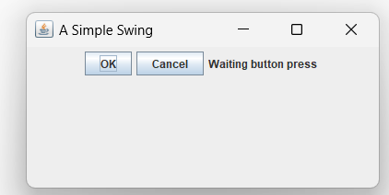
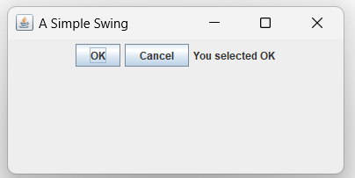
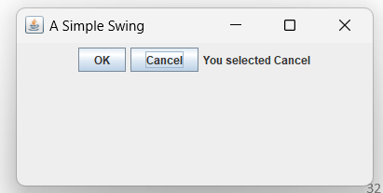
public void actionPerformed(ActionEvent ae)
{
jlab.setText("You pressed " + ae.getActionCommand());
}
public static void main(String args[])
{ SwingButton sb=new SwingButton();
}
}

Slide 33
JToggleButton
A toggle button looks just like a push button,
It acts differently from push button because it has two states:
  Pushed
  Released
When we press a toggle button, it stays pressed.
  It does not pop back up as a regular push button.
When we press the toggle button a second time, it releases (pops up).
Each time a toggle button is pushed, it toggles between its two states.
Toggle buttons are objects of the JToggleButton class.

Slide 34
JToggleButton(contd.)
JToggleButton implements AbstractButton.
JToggleButton is a superclass for JCheckBox and JRadioButton
JToggleButton defines several constructors.
JToggleButton(String str)
This creates a toggle button that contains the text passed in str.
By default, the button is in the off position.
When a JToggleButton is pressed in, it is selected.
When it is popped out, it is deselected.
JToggleButton generates an action event each time it is pressed.
JToggleButton also generates item event that signify whether it is selected/deselected.

Slide 35
JToggleButton(contd.)
To handle item events, we must implement the ItemListener interface.
Each time an item event (ItemEvent) is generated, it is passed to the itemStateChanged( ) method defined by ItemListener.
Inside itemStateChanged( ), the getItem( ) method can be called on the ItemEvent object to obtain a reference to the JToggleButton instance that generated the event.
Object getItem( )
To determine a toggle button’s state, call isSelected( ) method.
boolean isSelected( )
  It returns true if the button is selected and false otherwise.

Slide 36
import javax.swing.*;
import java.awt.*;
import java.awt.event.*;
class SwingToggleButton extends JFrame implements ItemListener
{ JFrame jfrm;
JToggleButton jtbn;
JLabel jlab;
SwingToggleButton()
{
jfrm = new JFrame("Simple Swing ");
jfrm.setSize(500, 400);
jfrm.setLayout(new FlowLayout());
jfrm.setDefaultCloseOperation(JFrame.EXIT_ON_CLOSE);
jtbn=new JToggleButton("On/Off");
jtbn.addItemListener(this);
jfrm.add(jtbn);
jlab = new JLabel("Button is OFF");
jfrm.add(jlab);
jfrm.setVisible(true);
}
public void itemStateChanged(ItemEvent ie)
{
if(jtbn.isSelected())
jlab.setText("Button is on.");
else
jlab.setText("Button is off.");
}

Slide 37
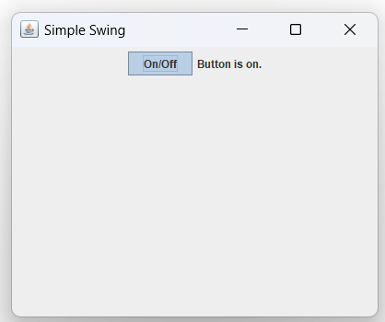
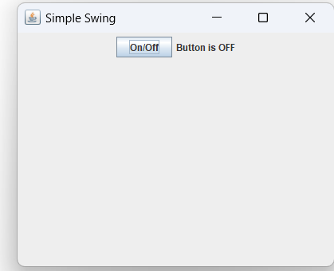
public static void main(String args[])
{
new SwingToggleButton() ;
}
}

Slide 38

JCheckBox
JCheckBox class provides the functionality of a check box.
Its immediate superclass is JToggleButton,
JCheckBox defines several constructors.
JCheckBox(String str)
When the user selects or deselects a check box, an ItemEvent is generated.
Inside the itemStateChanged( ) method, getItem( ) is called on ItemEvent object to obtain a reference to the JCheckBox object that generated the event
To determine the selected state of a check box is to call isSelected( ) on the JCheckBox instance.

Slide 39
import javax.swing.*;
import java.awt.*;
import java.awt.event.*;
class SwingJCheckBox extends JFrame implements ItemListener
{ JFrame jfrm;
JCheckBox cb;
JLabel jlab;
SwingJCheckBox()
{
jfrm = new JFrame("Simple Swing ");
jfrm.setSize(500, 400);
jfrm.setLayout(new FlowLayout());
jfrm.setDefaultCloseOperation(JFrame.EXIT_ON_CLOSE);
JCheckBox cb = new JCheckBox("C");
cb.addItemListener(this);
jfrm.add(cb);
cb = new JCheckBox("Java");
cb.addItemListener(this);
jfrm.add(cb);
cb = new JCheckBox("Python");
cb.addItemListener(this);
jfrm.add(cb);
jlab = new JLabel("Select language");
jfrm.add(jlab);
jfrm.setVisible(true);
}

Slide 40
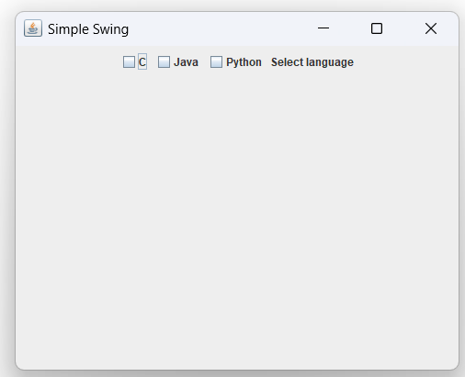
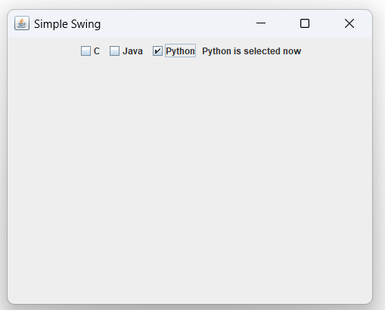
public void itemStateChanged(ItemEvent ie)
{ JCheckBox cb = (JCheckBox)ie.getItem();
if(cb.isSelected())
jlab.setText(cb.getText() + " is selected now");
else
jlab.setText(cb.getText() + " is cleared now");
}
public static void main(String args[])
{
new SwingJCheckbox();
}
}

Slide 41
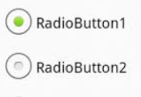
JRadioButton
Radio buttons are a group of mutually exclusive buttons, in which only one button can be selected at any one time.
They are supported by the JRadioButton class, which extends JToggleButton.
JRadioButton provides several constructors
JRadioButton(String str)
A button group is created by the ButtonGroup class.
Elements are then added to the button group via the following method:
void add(AbstractButton ab)
  Here, ab is a reference to the button to be added to the group.
A JRadioButton generates action events, item events, and change

Slide 42
JRadioButton(contd.)
We will normally implement the ActionListener interface with method actionPerformed( ).
  Inside this method we can check its action command by calling getActionCommand( ).
    By default, the action command is the same as the button label, but we can set the action command to something else by calling setActionCommand( ) on the radio button.
We can call getSource( ) on the ActionEvent object we can get which radio button is clicked.
We can simply check each radio button to find out which one is currently selected by calling isSelected( ) on each button.

Slide 43
import javax.swing.*;
import java.awt.*;
import java.awt.event.*;
class SwingJRadioButton extends JFrame implements ActionListener
{ JFrame jfrm;
JLabel jlab;
SwingJRadioButton()
{
jfrm = new JFrame("Simple Swing ");
jfrm.setSize(220, 100);
jfrm.setLayout(new FlowLayout());
jfrm.setDefaultCloseOperation(JFrame.EXIT_ON_CLOSE);
JRadioButton b1 = new JRadioButton("A");
b1.addActionListener(this);
jfrm.add(b1);
JRadioButton b2 = new JRadioButton("B");
b2.addActionListener(this);
jfrm.add(b2);
JRadioButton b3 = new JRadioButton("C");
b3.addActionListener(this);
jfrm.add(b3);
ButtonGroup bg = new ButtonGroup();
bg.add(b1);
bg.add(b2);
bg.add(b3);
jlab = new JLabel("Select language"); jfrm.setVisible(true);
}

Slide 44
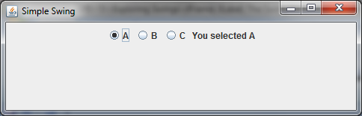
public void actionPerformed(ActionEvent ae)
{
jlab.setText("You selected " + ae.getActionCommand());
}
public static void main(String args[])
{ new SwingJRadioButton();
} }

Slide 45
JTextField.
JTextField is the simplest Swing text component.
JTextField allows you to edit one line of text.
  It is derived from JTextComponent, which provides the basic functionality common to Swing text components.
Three of JTextField’s constructors are :
  JTextField(int cols)
  JTextField(String str, int cols)
  JTextField(String str)
  Here, str is the string to be initially presented, and cols is the number of columns in the text field. If no string is specified, the text field is initially empty.
  If the number of columns is not specified, the text field is sized to fit the specified string

Slide 46
JTextField(contd.)
JTextField generates events in response to user interaction.
  For example, an ActionEvent is fired when the user presses ENTER.
  A CaretEvent is fired each time the caret (i.e., the cursor) changes position.
    CaretEvent is packaged in javax.swing.event
To obtain the text currently in the text field, call getText( )

Slide 47
JTextField(contd.)
import javax.swing.*;
import java.awt.*;
import java.awt.event.*;
public class SwingText extends JFrame implements ActionListener
{ JFrame jfrm;
JLabel jlab;
JTextField jtf;
SwingText ()
{ jfrm=new Jframe(“Simple Swing”);
jfrm.setLayout(new FlowLayout());
jfrm.setSize(500,400);
jlab = new JLabel(" Swing is powerful GUI");
jfrm.add(jlab);
jtf = new JTextField(15);
jtf.addActionListener(this);
jfrm.add(jtf);
jfrm.setVisible(true); }

Slide 48
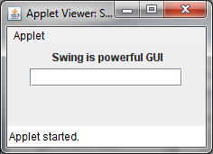
public void actionPerformed(ActionEvent ae)
{
jlab.setText(“You typed “+ jtf.getText());
}
public static void main(String args[])
{ new SwingText();
}
}
COMPILE USING
javac SwingText.java
RUN
appletviewer SwingText.java

Slide 49
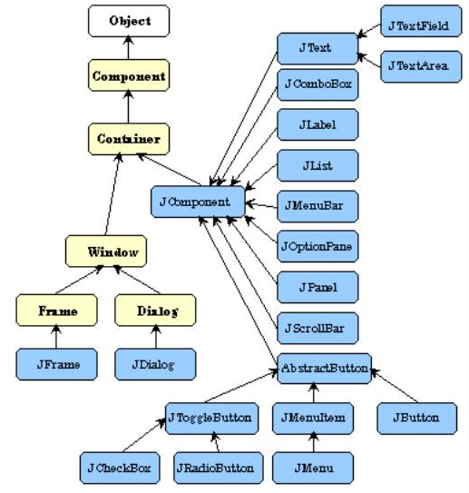
Class hierarchy of swing components

Slide 50
Reference
Herbert Schildt, Java: The Complete Reference, 8/e, Tata McGraw Hill, 2011.

